Slide 1
Data Governance Principles
VCSI-GEN-PMP-DAPG-003-A2

Slide 2
Versionning follow-up
Index | Date | Main changes | Proposed by | Reviewed by | Validated by
A0 | 27/02/2023 | First Issue | Ch. DE LIMERVILLE | C. VANEENOGE O. VERMONT | C. PERSOZ
A1 | 03/09/2024 | Added data consumers & producers processes | P. BRET | C. VANEENOGE O. VERMONT | D. DESMONS C. PERSOZ
A2 | 08/01/2025 | Update Data factory and interaction with data office | C. VANEENOGE | O. VERMONT | D. DESMONS C. PERSOZ
A3
Yellow = updates since release A2 (08/01/2025)

Slide 3
Summary
Data governance revolves around people, process and tools
In the following document, will be detailed:
Peoples: the data governance stakeholders (including data producer and data consumer) and their roles
Tools: quick overview of the data marketplace and the data catalog serving the end user (detailed user guide in another document)
Process: Data producer and data consumers user journey, interactions between people and tools.

Slide 4
INTRODUCTION
1

Slide 5
The Data Program provides access to data to business
From deliverables
What is Data Program ?
Big Bets
Big Bets
Big Bets
Big Bets
Data as
a product
Business
Ownership
Self-service
platform
Federated
governance
Give access to coherent data under different format, as reports or as raw data for self- service reporting or even AI.
For each data product a business sponsor is defined, this sponsor is the Data Owner. The Data Owner makes decisions on the data product with the help of an IT referent (Data Steward)
.The Data Program simplifies the discovery, search, and understanding of data through the Data Marketplace, the « Amazon of data ». Users can see existing data, quality metrics and request access.
Responsibility must be distributed across business entity & domains, as close to the business as possible.
Goal : Decentralize data by domain / business entity
DELI-GEN-PRE-DAPG-003-A1 Data Program - End user introduction

Slide 6



2. The Data Program enables to customize by entity based on trustworthy source
From deliverables
What is the purpose of the Data Program?
Reuse & Customize
A trustworthy source
Use A.I
The Data Program makes it easy to reuse existing data products.
It gives consumers the means to create their own analysis or customize existing one by adding local data.
The Data Program ensures:
1. A single source of truth via common repositories
2. Quality data thanks to rules, monitoring and managers.
The Data Program makes reliable data available, which is a prerequisite for extracting the full value of AI at VC.
(coming soon)
DELI-GEN-PRE-DAPG-003-A1 Data Program - End user introduction

Slide 7
People
2

Slide 8
People overview
Data governance involves many stakeholders with different roles
DATA CONSUMERS
Discover data products and use them
Might consume data products to create new ones
DATA PRODUCERS
Create and maintain data products over their lifecycle
DATA OFFICE
Defines and administers data governance policies
Promote data culture within the organization
Support domain teams in the creation of their data products
DATA PLATFORM TEAM Provides data governance platform, technical starter kit and best practices
Roles
We are a small team, and we need a development team to build our Power BI Reports.
DATA MARKETPLACE - SELF-SERVCE DATA PLATFORM
DATA OFFICE
We need access to this data product to cross-reference it with other data.
DATA PRODUCERS*
DATA CONSUMERS
How can I share my data in a secured and governed way?
DATA PLATFORM TEAM
Can anyone help me find the data needed for my business use case?
We would like to create a new data product. What are the best practices for joining the Data Program?
Interactions
Notes:
Idée: construire une slide de récap en détaillant juste les consumers/producers
Mettre une pastille « vous êtes ici » selon les interlocuateurs

Slide 9
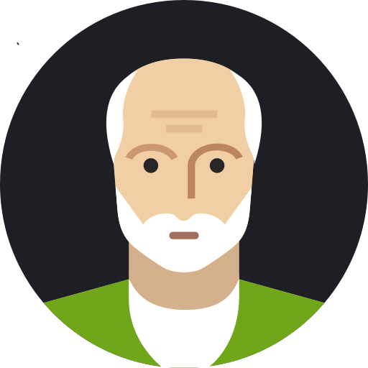






Data consumers overview
The data consumers are the “customers” for a data product. They use, reuse and customize reports or AI models for their specific needs.
DATA CONSUMERS
Discover Data Products for their analytical activities and use them in a performant and compliant way.
Main data consumer
Business
IT
Business user
Citizen Data Analyst
Data Analyst
Data Analyst Adv
Data Engineer
Application Developer
Data Scientist
Search and use the knowledge extracted from the Data Products.
Business Users with data culture skills, non data specialists, who use Business Intelligence tools to make data analysis.
Translates information from data teams into knowledge that can be understood by business users
Provides clean, sorted and aggregated data sets for data visualization
In charge of building the analysis device and publishing the data sets. Uses the content of the data to extract analytical information.
Build applications using data from different sources
Performs classification and statistical prediction algorithms to optimize business processes.
Business skills
IT skills
EXCEL - AFO
POWER BI, SAP, SAP Analytic Cloud, …
CODE (Python, C#, ABAP, SPARK, … ), Database langage (SQL, SAP Hana, …)

Slide 10

Data producers overview
The data producer is the “supplier” for a data product. Each data product must have a Owner, a Steward and a Data Factory. They ensure availability and reliability of data.
DATA PRODUCERS
Create and maintain data products throughout their life cycle
Data Product Owner
Data Analyst
Data engineer
Defines need and arbitrates
Responsible for Self-describing & Defining aspects of the Data Product.
Qualify Use case
Translates needs in specs & tests
Builds Bi reports
Responsible for Discoverable & Secure aspects of the data product
Builds data product
Builds BI reports
Responsible for Accessible & Secure aspects of the data product
Business
IT
Inside domain or data factory team
IT
Inside data factory team

Slide 11


Central teams overview
The Data Office and Data Platform team provide respectively a governance and a technical framework to work with data. They facilitate access to data.
DATA PLATFORM TEAM
DATA OFFICE
Data Officer
Data Platform Product Owner
The data office is the single point of contact for data consumer
The data office missions :
Qualify data use case, redirect to the appropriate data factory, monitor advancement and adoption
Define and implement data governance (roles, responsibilities and process)
Animate the data community
The Data Platform Team provides a self-service data platform in order to create the rules and standards for how data should be managed and used, so that it is secure and reliable for the entire organization. Brings best practices & data governance solutions for central data discovery and observability of data products.
Data Analyst
Data governance facilitator
Data community coordinator
Data Platform engineer
Enterprise architect
Qualify Use case
Help publish data product
Manage data catalog
Coach data consumers,
Monitor data product adoption
Build technical template for data products
Design Data platform
Design technical template for data products

Slide 12




Roles - Recap
DATA PRODUCERS
Data Product Owner
Data Analyst
Data engineer
IT
Inside domain or data factory team
IT
Inside data factory team
Business
Defines need and arbitrates
Responsible for Self-describing & Defining aspects of the Data Product
Qualify Use case
Translates needs in specs & tests
Builds BI reports
Responsible for Discoverable & Secure aspects of the data product
Builds data product
Builds BI reports
Responsible for Accessible & Secure aspects of the data product
DATA
OFFICE
Data Officer
DATA PLATFORM TEAM
Data Platform Owner
Data Analyst
Data governance facilitator
Data community coordinator
Data Platform engineer
Enterprise architect
IT
Inside data office team
IT
Inside data office team
IT
Inside data office team
IT
IT
Qualify Use case
Help publish data product
Manage data catalog
Coach data consumers,
Monitor data product adoption
Build technical template for data products
Design Data platform
Design technical template for data products

Slide 13
Data Program activities
Use case qualification
Data Product Build
Data Product Publication
Activity:
Collect & challenge business needs,
Analyze data sources
Initial project quote and planning
Metrics:
Assessment time ( from ask date to quote date)
Number of use cases in the backlog (in and out)
Activity:
Design and dev data product
Deploy and maintain data product
Metrics:
Time to market ( from kick off date to go live date)
Number of data products delivered
Activity:
Help data producers document on data marketplace
Monitor data marketplace doc quality
Administer Data Marketplace
Metrics:
Number of data products documented & published
Quality indicator to be defined
Data Product Usage
Data platform
Activity:
Train and coach data consumers,
Monitor data product adoption
Metrics:
Number of end user coached
Number of data product consumed (report or self-service)
Activity:
Define and implement reference architecture
Setup, maintain and monitor the data platform
Metrics:
Number of incidents on data product due to data platform
Number of technical template
DATA OFFICE
DATA PRODUCERS
DATA PLATFORM
Budget data program
Budget Data factory

Slide 14
Data Program stakeholders
Legend
Business Team
IT Team
SPONSORS / STEERING COMMITTEE
Gilles GODARD
Digital Transformation Director
Olivier PELLET
VCSI Director
Christophe PERSOZ
Connect Performance Director
Didier DESMONS
VCSI Department Director
PROJECT LEADS
Camille VANEENOGE
Project Manager
Olivier VERMONT
Data Platform Lead
DATA FACTORIES
DATA OFFICE
DATA PLATFORM
XXX
Data Factory Lead – MS Techno
Dominique POLVERELLI
Data Factory Lead – SAP BW Techno
Camille VANEENOGE
Data Officer
Olivier VERMONT
Data Platform Lead
Budget Data program
+ Divisions / Delegations
Data factories
Pierre BRET
Data office lead
DATA PRODUCT BUILD
USE CASE QUALIFICATION
DATA PLATFORM
BI BUILD
DATA PRODUCT PUBLICATION
AI MAKERS
DATA PRODUCT USAGE
Victorien MELOT
AI Lead
AI BUILD
ENTERPRISE ARCHITECTURE
CHIEF INFORMATION SECURITY OFFICER
DATA INTEGRATION
DOIT

Slide 15
















Data Factories across VINCI Construction
Maestro? République tchèque / Slovaquie? Afrique? Chili? iBim? Via IMC?
Mircel uniquement NZ ou aussi Australie?
Qui chez Franck Noze s’occupe de la data? Est-qu’il y a des data engineer?
America Oceania
VC Canada
Domenic DENTICO
UK
UK Division SC
Trevor WRIGHT
11 People
( 4 data engineers)
America Oceania
USA Holding
Rafael KLEIN
2 People
(1 data engineers)
Europe Africa
Poland IT
Anna KIDUIK
5 People
(1 data engineer)
Specialty Networks
SF Holding
Matthieu COBAT
3 People
(1 data engineers)
Specialty Networks
Sixense Digital
Frederic DELRIEU​
8 People
(2 data engineers)
Europe Africa
Germany IT
Hendrick STAMME
5 People
(3 data engineers)
Max
Major Projects
VCGP Siege
5 People
(3 data engineers)
[0 to 100[
[100 to 200[
America Oceania
Australia
[200 to 300[
Hani ARAB
5 People
(4 data engineers)
[300 to 400[
Emna REGAIEG
Camille TRAN
400+
400+
400+
400+
France Divisions
Central services
Min
David VINCENT
14 People
(6 data engineers)
400+
America Oceania
New Zeeland
400+
Mircel VAN DER WALT
Holding
Central services
SAP BW
Dominique POLVERELLI
Holding
Central services
Sage
16 People
(12 data engineers)
Holding
Central services
Microsoft
Data factory :
10 People
(5 data engineers)
Vincent AUGIER
1 People
(1 data engineers)
Raphael ZIRMI
Camille VANEENOGE
Internal + external people
To our knowledge so far

Slide 16
Data office and data factories/producers interactions
Major evolution
Qualification
Design
Development
Tests
Publication
Usage + Run
Business need
Data Officer
Data Product Owner
Data Product Owner
Data engineer
Data Product Owner
Data Product Steward
Data engineer
The data officer decides who performs the qualification, depending on the complexity of the requirement:
New requirement
Several data sources
Request Evolution
Addition of new sources
Data Analyst
Data Product Steward
Data Product Steward
Data governance facilitator
Data community coordinator
Data engineer
Data Office
Data Producers

Slide 17
Example : Procurement diagnosis Use Case
Business
IT
IT domain team
Data factory team
Data office team
Business Sponsor | Franck Dupont + Christophe Persoz
Business Lead | Graziela Alati
IT Sponsor | Christophe Charoy + Jean-Baptiste Delaunay
IT Lead | Emmanuel Peigne
Data factory lead | Camille Vaneenoge
Core team
Data owner | Graziella Alati
Data Steward | Héloïse Fabre + Othman Ben Jemaa
Data Engineer | Aida Romdhane
Data consumer | Coordinateur Achats
DevOps | Simon Soulié
Tech lead | Thomas Marencic
Data Consumer
Data Producer
Data Office
Transversal
* The Data steward is the project manager

Slide 18
Example : HS Board use case
Business
IT
IT domain team
Data factory team
Data office team
Business Sponsor | Regis Amberni
Business Lead | Regis Amberni
IT Sponsor | Camille Vaneenoge
IT domain Lead | Elyse Bastien Camille Tran
Data factory lead | Camille Vaneenoge
Core team
Data owner | Regis Amberni Tacfarinas Ait Hamoudi
Data Steward | Othman Ben Jemaa
Data Engineer | Rémy Touret
Data consumer | HS Board
Tech lead | Thomas Marencic
Data Consumer
Data Producer
Data Office
Transversal
* The Data steward is the project manager

Slide 19
TOOLS
3

Slide 20




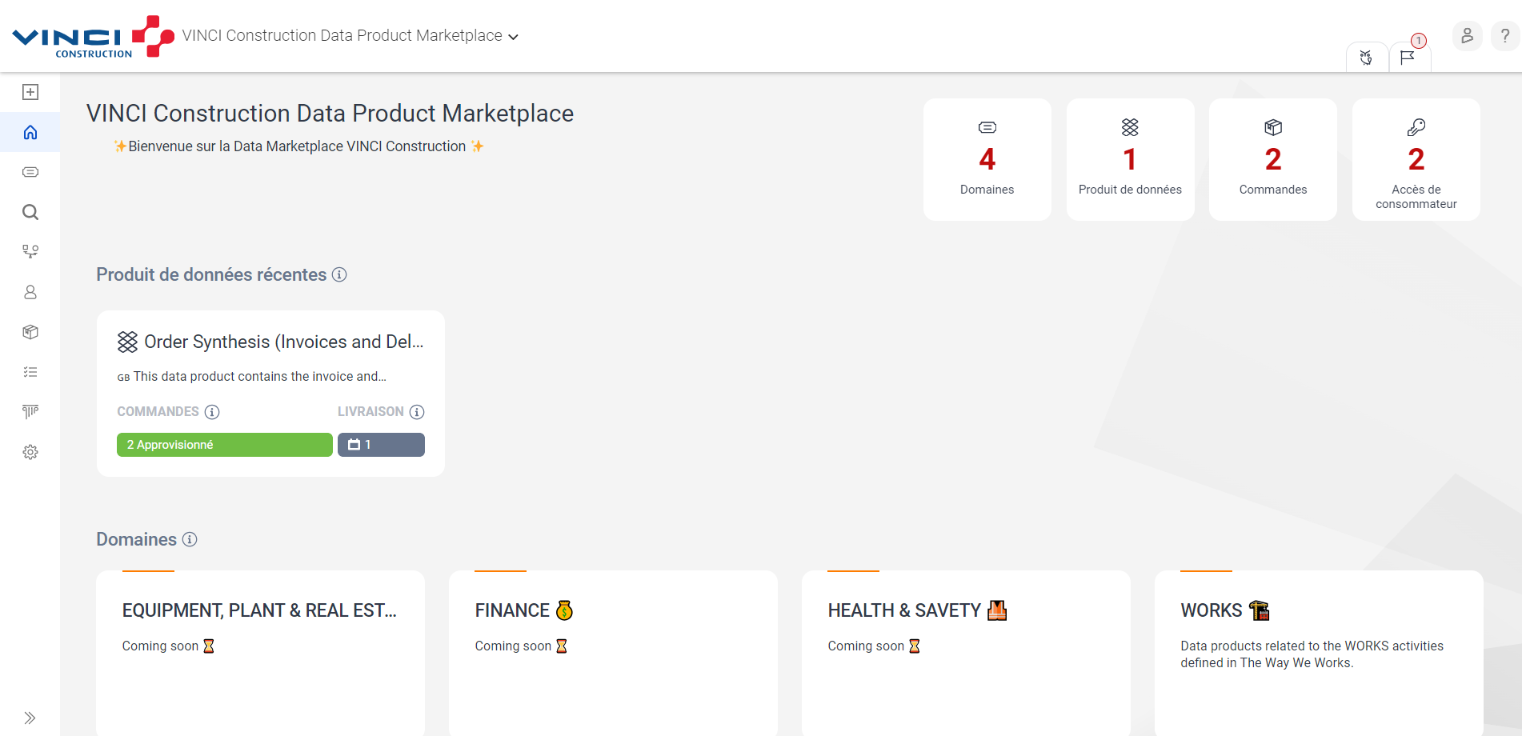
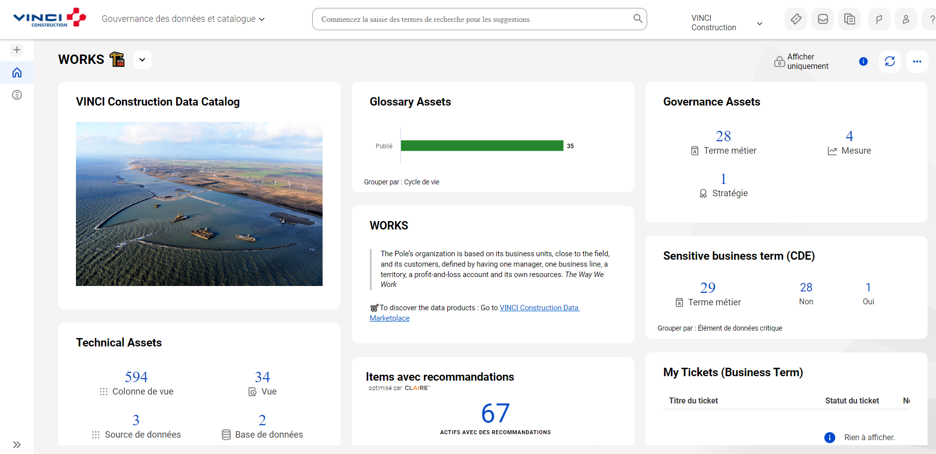
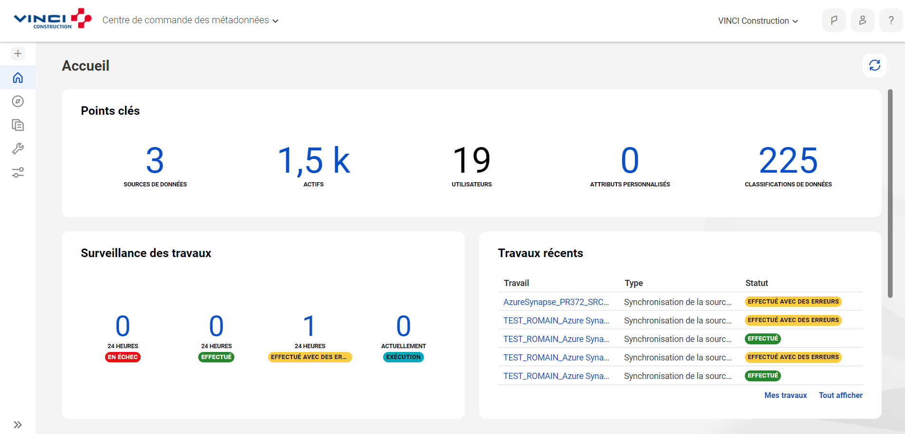
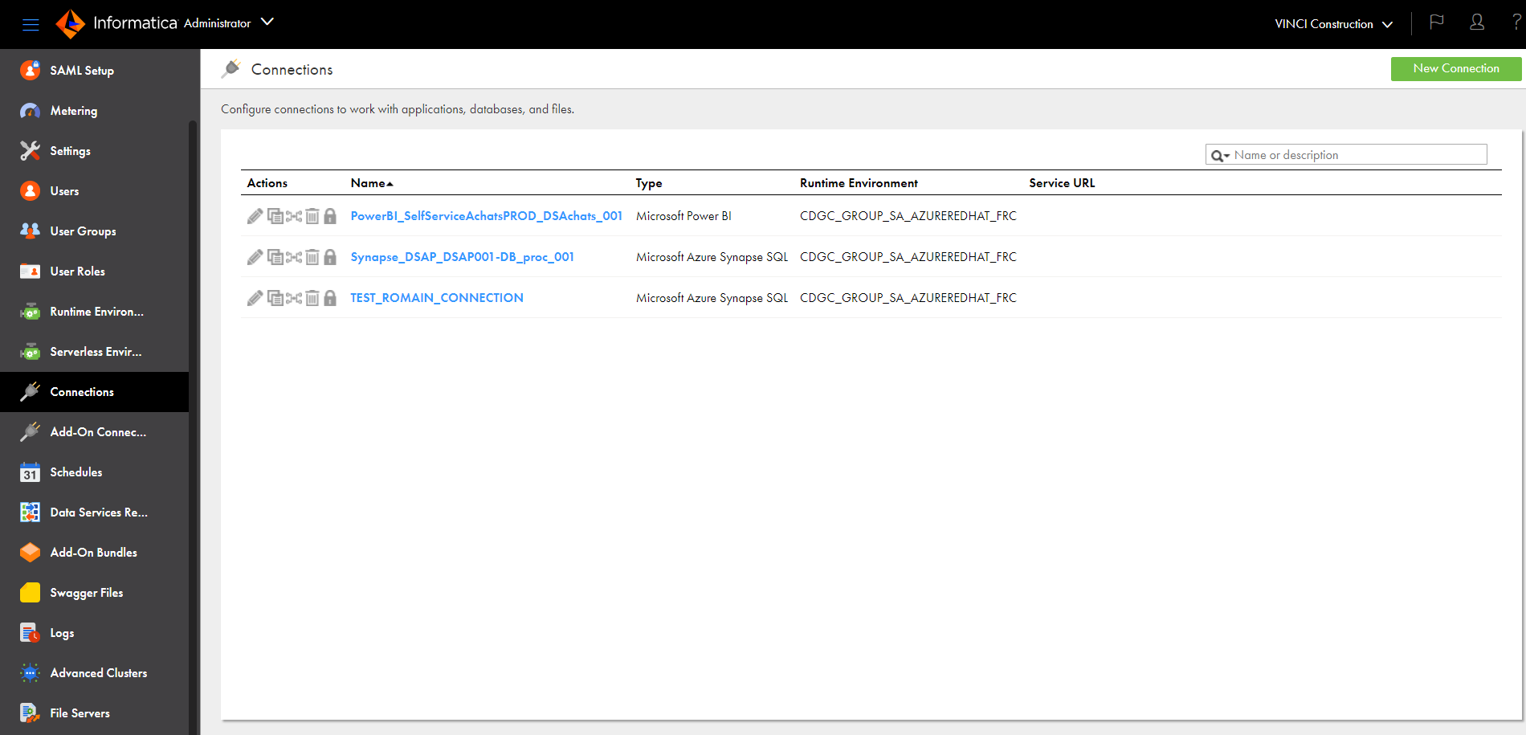
Tools overview
For data governance, informatica was chosen and is composed of 4 modules.
For Later Use
Discover Data Product
Document Data Product
Scan Data Sources
Monitor Usage
Data Marketplace
Data Catalog
Metadata Command Center (MCC)
Administrator
Key Points
Democratize access to data
Discover existing data products and their documentation
Ask for access
Key Points
Create data product documentation based on scanned metadata
Create and associate Business terms
Key Points
Scan metadata and suggest associated data classification and business terms
Schedule jobs
Key Points
Create connectors
Set user roles and groups
Monitor license consumption (IPUs)
Data Office ./ Data Platform
Data Consumer
Data Producers

Slide 21
Use case exemples
For Later Use
Access Data Marketplace to discover and order Data Products
DATA PRODUCERS
Expose Data Product
DATA CONSUMERS
Give access to Data Product
Contact Data Producers
Data Marketplace
Access detailed info for advanced data consumers
DATA PRODUCERS
Document Data Product
DATA CONSUMERS
Data Catalog
DATA PRODUCERS
Scan Data Sources and get metadata
Metadata Command Center

Slide 22
SCENARIOS & PROCESSES
4

Slide 23

Data consumption scenarios
Data consumption scenarios have been defined to enable business users to meet their business needs by leveraging data analytics
Business needs
Data consumption scenarios
Create ad hoc reports from existing data products
Cross-reference available data with other external ones to build new reports or data products
Use advanced analytics to discover new data insights
Answer local needs for global data product (Germany BI-PRIS for example)
Scenario 1 : Existing reporting
Scenario 2 : Self-service BI
Scenario 3 : Advanced Analytics Self-Service (AI, statistical model, algorithm, … )
Scenario 4 : Application integration
The Data Marketplace helps Data Consumers easily find relevant data products in VC organization.

Slide 24
Data consumption scenarios
To summarize there are multiple paths to consume data products, Data Program must define governance, architecture principles and processes for supporting these scenarios.
Scenario 3
Advanced Analytics Self-Service
(From Self-Service BI to AI)
Scenario 1
Existing Reporting
Data Analyst
Data Analyst Advanced
Data Scientist
Data Engineer
Business user
DATA PRODUCTS
Scenario 2
Self-service BI
Scenario 4
Application integration
Data Engineer
Citizen Data Analyst
Application Developer

Slide 25
Processes
# | Process name
1 | Use the data Marketplace
2 | Data Producers Onboarding
3 | Data Product Creation in Data Gov Solution
 | 3.1 | Scan Data / Schedule Jobs
 | 3.2 | Create Data Product in Data Catalog
 | 3.3 | Create Data Product in Data Marketplace
4 | Modify / Create Asset in Data Catalog
5 | Give access to Data Product in Data Marketplace
For Later Use
For Later Use

Slide 26
Use the data Marketplace
For Later Use
1
Request an upgrade
Request access
Identify the necessary data
Discover Data Product
Data knowledge
Find informations
Does the data exist to answer my business question?
Data consumer
Exploring the platform and metadata

Slide 27

Onboard data producers
2
Review request
Create/Add requester to the right group
Notify requester
Data
Office
Onboarding meeting
MySupport
Administrator
MySupport
Send an onboarding request to the data office
Data
Owner
MySupport
Data
Steward
Legend
Process Step
Process Decision

Slide 28
Scan Data Sources / Schedule Jobs
3.1
Request a new data source
Complete the list of prerequisites
Validate Metadata scan
Validate quality rules & perf impacts
Data
Steward
Data Catalog
Data Catalog
Transmission of a list of prerequisites
Create Connectors and new data source
Scan Metadata
Run Data Classification + glossary association Jobs
Test quality & profiling jobs (on a sample)
Run Jobs quality & profiling (full)
Assign data producers' authorizations
Schedule Jobs (optional)*
Data
Office
Administrator
MCC
MCC
MCC
MCC
MCC
MCC
MCC : Metadata Command Center (see slide 19)
Legend
* Possible jobs include: metadata scanning, classification, glossary association, profiling and quality rules.
Process Step
Process Decision

Slide 29
Document Metadata in Data Catalog
3.2
1.0 Define and validate business terms
Data
Owner
Regroup scanned metadatas
Associate Business Terms to scanned metadatas
Assign Data Classification* to metadata
Data
Steward
Review & Import Business Terms to Glossary
Data Catalog
Data Catalog
Create New Data Classification
Data Catalog
Data
Office
If needed
Data Catalog
Data Catalog
Data Classification : Process of identifying and organizing data into relevant categories based on the functional meaning of the data
Legend
Process Step
Process Decision

Slide 30
Create Data Product in the Data Marketplace
For Later Use
3.3
Validate Data Product
Data
Owner
Data Marketplace
Import Tables and their documentation from data catalog
Complete Data Product ID card
Associate relevant delivery targets (ex : PBI, SQL) and usage context (AI / Analytics)
Add Terms of Use (rules to respect)
Publish Data Product
Data
Steward
Data Marketplace
Data Marketplace
Data Marketplace
Data Marketplace
Data Marketplace
Create Delivery Targets and Usage Context
Create terms of use
Data
Office
If needed
If needed
Data Marketplace
Data Marketplace
Legend
Process Step
Process Decision

Slide 31
Request a dataproduct variation in data marketplace
For Later Use
4
5.0 New product developpment
Data
Factory
Data
Office
6.0 Add the new product to catalog & marketplace
3.1 Close ticket by denying request
3.2 Inform Data Office
4.0 New product specification *
Refusal
Data
Steward
Data Catalog
Data Marketplace
2.0 Arbitration
Data Marketplace
Data Marketplace
Data
Owner
Validation
1.0 Request for a product variation
7.0 Ticket closing notification
Data consumer
Data Marketplace
Data Marketplace
* Optionally, Data Office can help with step 5.0
Legend
Process Step
Process Decision

Slide 32
Give Access to Data Product in Data Marketplace
For Later Use
5
Arbitration?
Data
Owner
Yes
Close ticket by denying request
Give access to Data Consumer by following Deliveries Conditions
Close ticket
Data
Steward
No
Create a ticket to access to Data Product
Data Marketplace
Data Marketplace
Ticket closing notification
Data consumer
Data Marketplace
Data Marketplace
When you withdraw access to data, don’t forget to withdraw access in the data marketplace
Legend
Process Step
Process Decision

Slide 33
The catalog of services proposed by the Data Office and the Data Platform teams enables domains to quickly increase the business value derived from enterprise data
Scope new data-driven business use cases for domains
Develop data culture in the VC organization
Maintain a data catalog of data products across the entire VC organization
KPI : Number of use cases scoped by data office
KPI : Number of published data sources, User traffic
DATA MARKETPLACE - SELF-SERVCE DATA PLATFORM
Support the domains in the implementation of new roles (Data Product Owner, Data Steward) & acculturation
Define the key principles (processes and tools) for sharing data within the VC organization
DATA OFFICE
KPI : Number of domains implementing the new role model
DATA PLATFORM TEAM
A data platform infrastructure helping domains to build new data-driven use cases with standard ready-to-use features
Provide best practices for new data products (E-Capex…)
KPI : Number of
workspaces
KPI : Number of use cases hosted in the data platform,
Time for the provision of the infrastructure
KPI : Number of use cases supported
Bring a Sandbox (test platform) to Analytics users

Slide 34
APPENDIX
5

Slide 35

Glossary Data Marketplace
For Later Use
Understand Informatica vocabulary for Data Marketplace
Domain | Element grouping together several Data Products. Similar to the OnlineHelp domain.
Data Product | Main element of the marketplace made up of tables to which users request access in order to exploit the linked data.
Tables | Grouping of several data elements (see definition below)
Data Element | Smallest element in the Informatica object hierarchy. Most of the time they represent a column inside a table. Data elements come from the data catalog.
Delivery | Data product delivery is made of three elements: the format (pbx, tables, etc.), the method (link, access group, etc.), and the model.
Terms of use | Represents the terms of use of a data product, which also indicates whether the data product has controlled use or is accessible.
Data Marketplace

Slide 36

Glossary Data Catalog
Understand Informatica vocabulary for Data Catalog
Glossary | Organization dictionary with business terms organized by field
Domain | A domain is a type of data glossary asset that refers to a collection of business concepts and activities grouped together for a specific business requirement. A domain generally contains sub-domains within its hierarchy.
Sub-Domain | A sub-domain is a type of data glossary asset to which you can assign a concept or activity that constitutes a specific business requirement or function. A sub-domain usually exists in a hierarchy and belongs to a domain.
Business Terms | A business term is a type of data glossary asset that corresponds to the definition of a single business concept, function or activity..
Measure | A measure is a type of data glossary asset that refers to the numerical measurement of a business result.
Dataset | A dataset refers to a group of data elements represented as a single asset. Datasets can be grouped together to form a system.
System | A system is the business representation of data that is a container for the data elements and data sets in your organization.
Data Catalog | Informatica module : listing of all the data products and their metadata (based on systems and datasets)
Fields | Object representing a scanned column in a data catalog
Lineage | Lineage is a process that aims to provide a visualization of the data life cycle by tracing the source of the data and the transformations it has undergone.
Relation | Panel showing relationships with the object concerned
Data Source | Scanned data source used to create data catalogs
Data classification | Process of assigning categories to fields based on their content. Exemple of category/class include “Adress”, “phone number”, “Name”, “Passport number”... Classifying data allows a better governance of sensitive data and is a general documentation best practice.
Data Catalog

